Slide 1
Lecture 05
Computer Assembly
CT4005NI - Computer Hardware and Software Architectures

Slide 2
Lecture 05’s Objectives
Identify the required and recommended components to build a basic PC
Describe the correct procedure to assemble a desktop computer

Slide 3
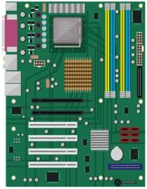
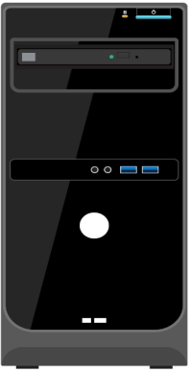
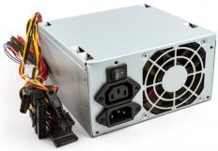
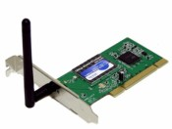


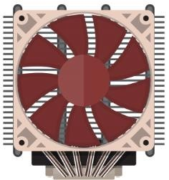
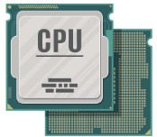
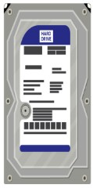
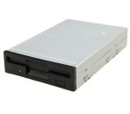
Assembled PC
An assembled computer is built by purchasing or collecting components for it from different manufacturers
These components then need to be fit together to create a complete
computer system.

Slide 4

Assembling a computer
One of the most crucial and critical jobs for a computer technician, as correct techniques and procedures need to be followed.
We will learn how to assemble a computer in a methodical manner

Slide 5

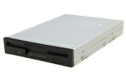




Components needed to build a basic PC
Power Supply Unit
CPU
Motherboard
RAM
Case
Storage drives
Fan assembly
Monitor
Adapter Cards

Slide 6
Recommended components for a basic assembled computer
Case, power supply unit and motherboard of the mATX form factor of any brand or manufacturer
Processor of at least intel i5 or equivalent
RAM of at least 8 GB as per the DDR slot on the motherboard
Fan set cooling system
SATA hard disk of at least 500 GB and SSD of at least 128GB
18.5-inch LCD or LED monitor of any brand
Multimedia keyboard and mouse of any manufacturer

Slide 7

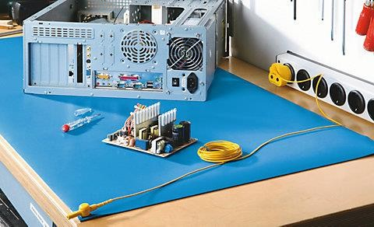
Prepare the workspace
There should be adequate lighting, good ventilation, and a comfortable room temperature in the workspace
Anti-static mat will help prevent ESD damage

Slide 8
Assembling a computer – Steps
Open the case
Install the power supply unit
Install the CPU, heat sink and the fan assembly Install RAM
Install motherboard Install internal drives
Install optical drive
Install adapter cards
Install cables
Boot the computer for the first time

Slide 9
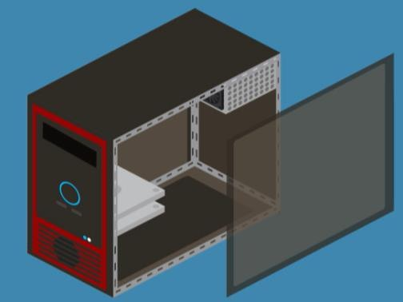
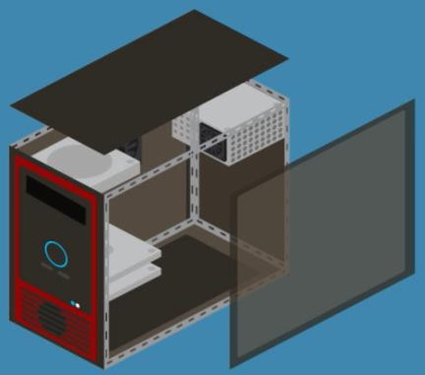
Assembling a computer – Open the case
Most of the computer cases are opened from only one side
Some other computer cases can be opened from
The top or the side
The top first and then from the side
Consult the case’s documentation to learn how to open a particular case

Slide 10
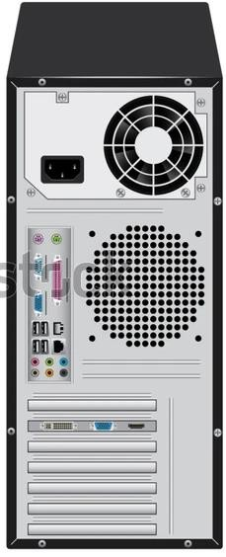
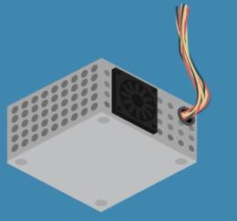
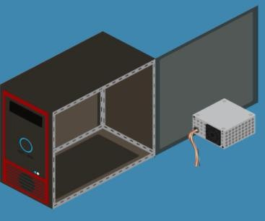
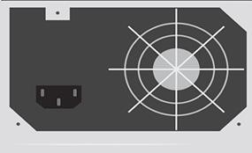
Assembling a computer – Install the power supply unit
Most power supply units can only be fitted in one way in the computer case, fitting it in upside down might not be supported.
Steps
Identify the correct side for installation Insert the power supply unit into the case
Align the holes of the power supply unit with the holes in the
Fit the power supply in the case using the proper screws

Slide 11
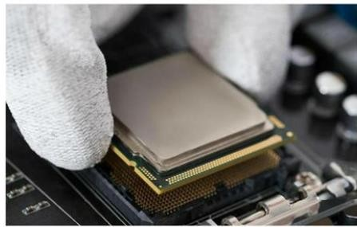
Assembling a computer – Install the CPU & cooling system
Install the CPU, heat sink and fan assembly on the motherboard before the motherboard is placed in the computer case.
CPU and motherboard are highly sensitive to ESD.
Use the markings on the CPU and motherboard to properly align and install the CPU
Install the CPU in the CPU socket using the ZIF mechanism and matching the notches
Apply thermal compound.
Thermal compound help dissipate CPU heat.
Clean CPU first if necessary, with isopropyl alcohol
Align the heat sink and fan and install them correctly

Slide 12
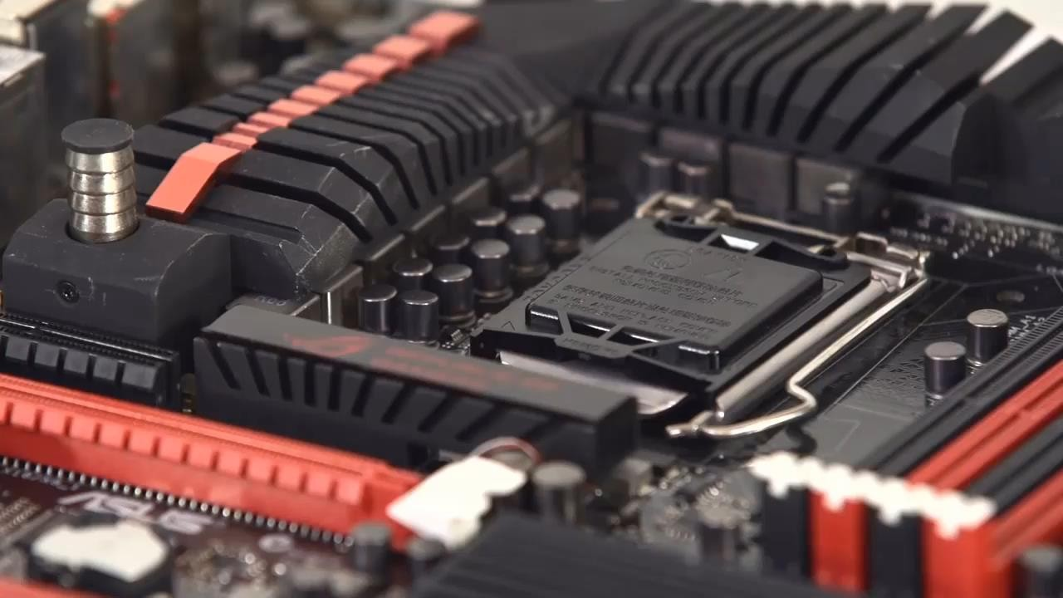
Assembling a computer – Install CPU & cooling system

Slide 13
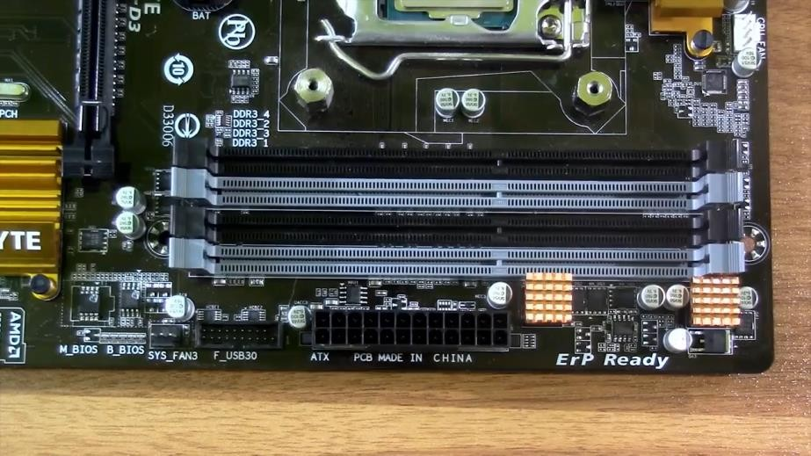
Assembling a computer – Install RAM
Unlock the locks of the RAM slot if they aren’t yet unlocked
Install the RAM, matching the notch RAM is designed to install in one specific direction
Make sure to check the markings before applying pressure

Slide 14
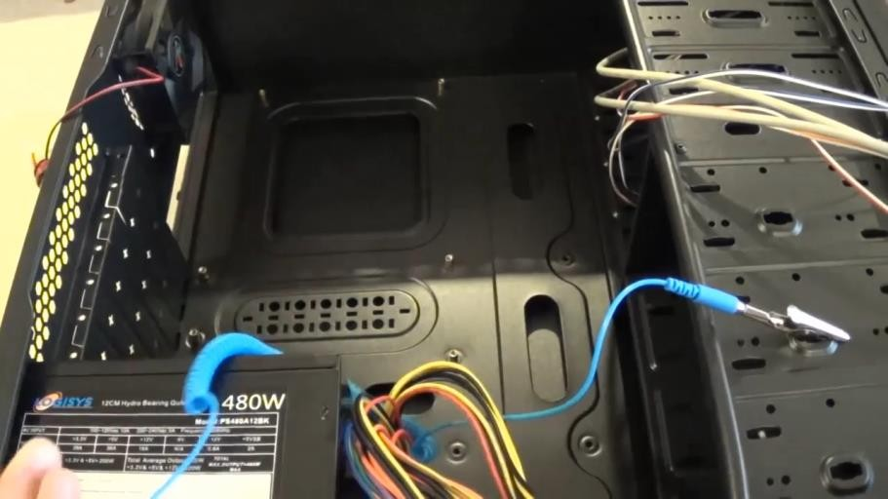
Assembling a computer – Install Motherboard
Use proper plastic standoffs to securely install the motherboard in the case and avoid short circuits
The I/O connectors on the back of the motherboard should be aligned with the openings in the I/O plate

Slide 15
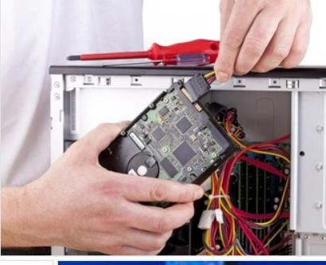
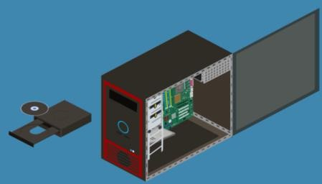
Assembling a computer – Install internal drives
Internal drives are installed in empty bay. The empty bay must match the drive’s size. Leave some space between the drives when installing multiple drives
The drive’s metal plate should face up to allow
better heat dissipation
Install the Optical Drive.
These are commonly installed in 5.25 inch (13.34 cm.) drive bays.
Optical drives are accessed from the front of the case.

Slide 16
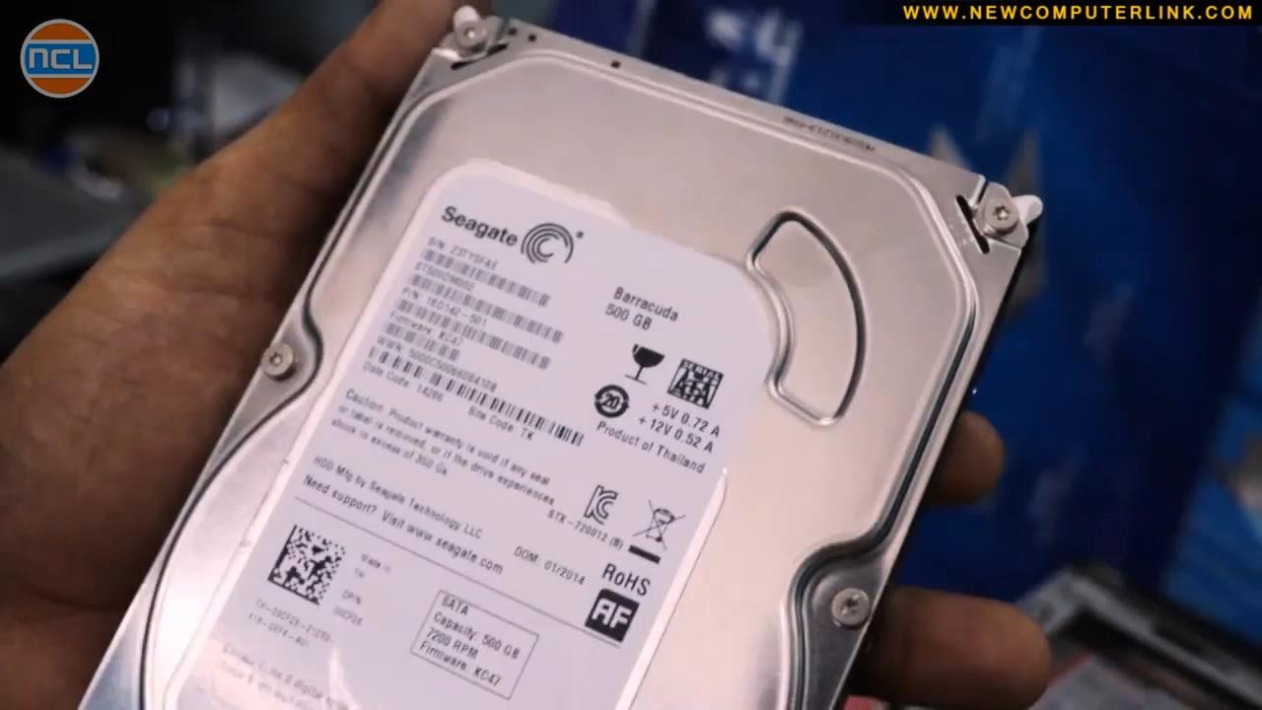
Assembling a computer – Install internal drives

Slide 17
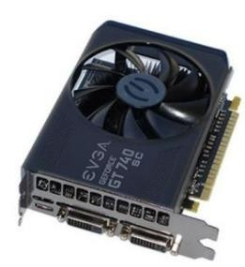
Assembling a computer – Install adapter cards
Commonly use PCI or PCIe expansion slots or USB connectors
Locate an empty expansion slot and follow the manufacturer instructions for proper installation
Install a Video Adapter Card Commonly uses PCI, AGP or PCIe expansion slots
Many video cards require an external power supply in the form of two 8-pin power connectors
Due to their cooling systems, modern video cards take more space inside the case. Be sure to plan for the extra space needed.

Slide 18
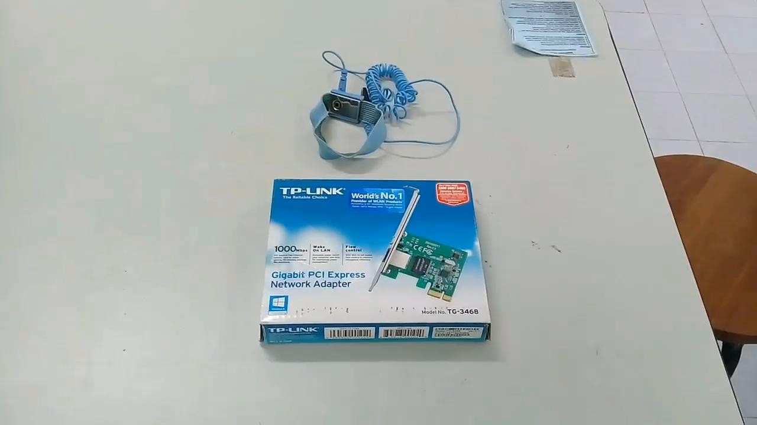
Assembling a computer – Install adapter cards

Slide 19
Assembling a computer – Install internal cables
Connect Power to Motherboard. Motherboards require power to operate.
Motherboards also relay power to components and adapter cards.
Refer to the motherboard and power supply documentation to ensure compatibility of power supply and motherboard connectors.
Modern motherboards require two power connectors for operation—P1 24-pin connector and 4-pin CPU voltage regulator Align the proper connectors and press it down against the motherboard.

Slide 20
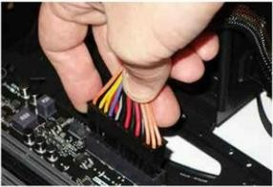
Assembling a computer – Install internal cables
Connect Power to the internal drives and case fans
4-pin Molex and 15-pin SATA are common hard drive connectors
Align the proper connectors and gently press it against the other end
Fans also need power and use 3-pin or 4-pin connectors

Slide 21
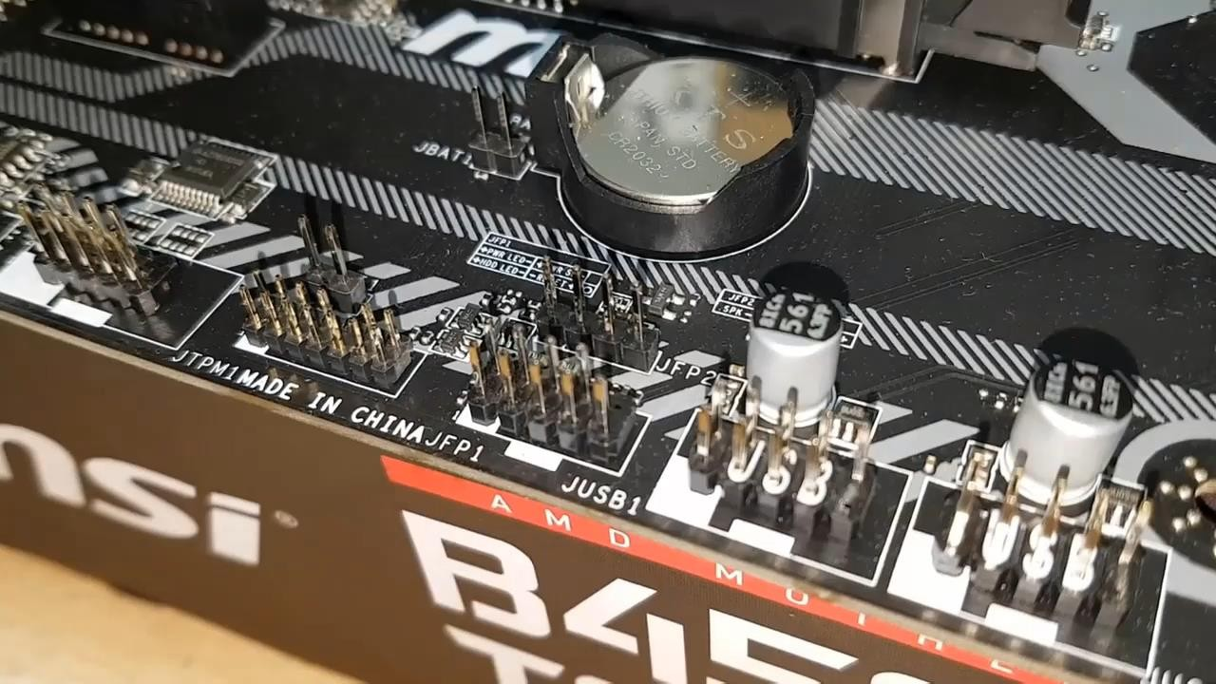
Assembling a computer – Install front panel cables
Plug the reset switch, power switch, HDD-LED, speaker and power LED connectors into the motherboard, all label facing upwards

Slide 22
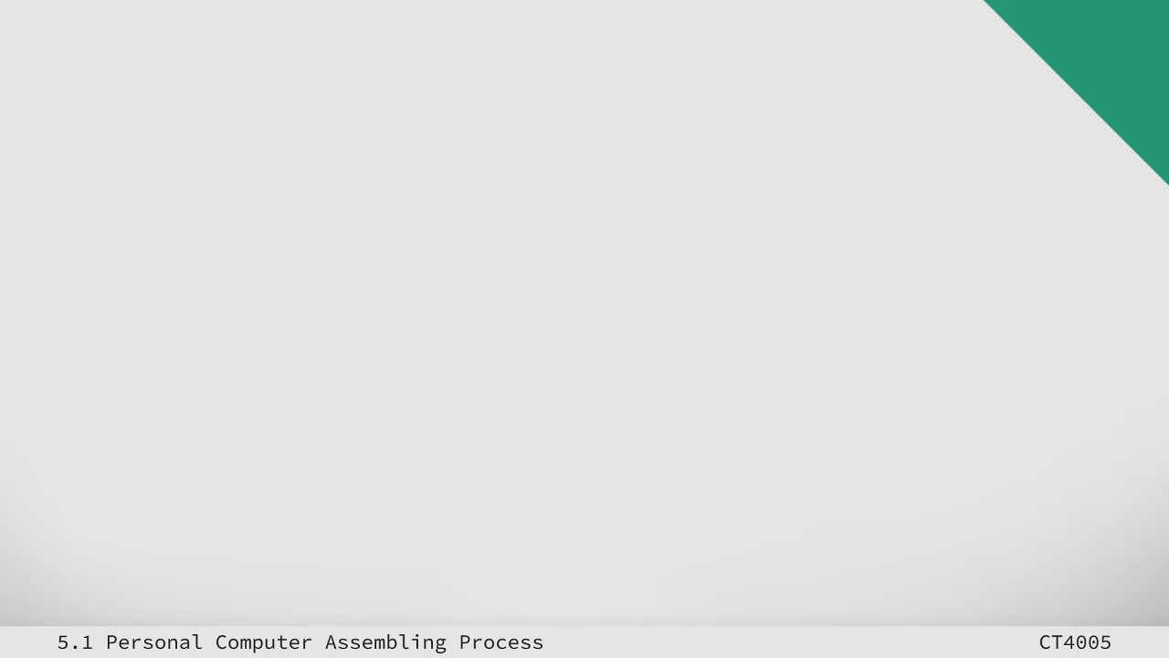
Assembling a computer – Reassemble the case
Close the side/top panels Secure case cover screws
Watch for small wires hanging off the case to avoid pinching them
Connect external cables
Boot the computer

Slide 23

End of Lecture for week 05
Any question ?

